Slide 1
pyGRAZ Website Coding Dojo
2022-12-06

Slide 2
What is a Coding Dojo?
Dojo = learning environment (originally from martial arts)
Applies
  Pair programming
  “baby steps”
  Test driven development (if we are so inclined)
Together we solve specific programming problems
Goal: Fun experience for everyone while learning something
See also: https://humberto.io/blog/coding-dojo-101/

Slide 3
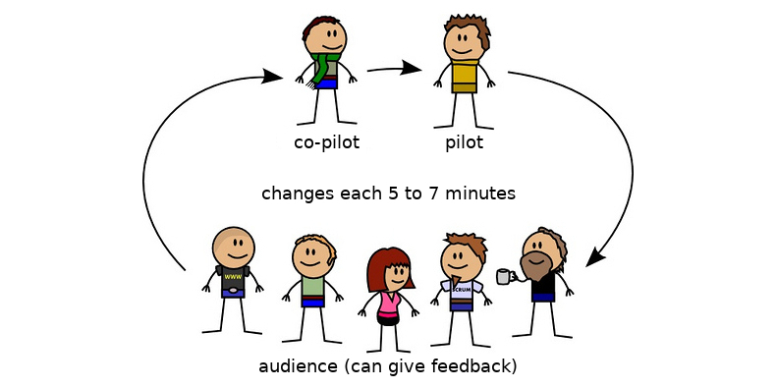
How does it work?
Pilot codes
Co-pilot gives opinion on code
Rotation with audience every couple of minutes
If stuck:
  Documentation
  Stack overflow
  Ask audience for help
Respectful and supportive environment

Slide 4
What’s are the tasks?
Improve the pyGRAZ homepage!
Learn a little bit of software development process while doing it
The tasks can be found in the pyGRAZ Kanban board: https://github.com/orgs/pygraz/projects/1

Slide 5
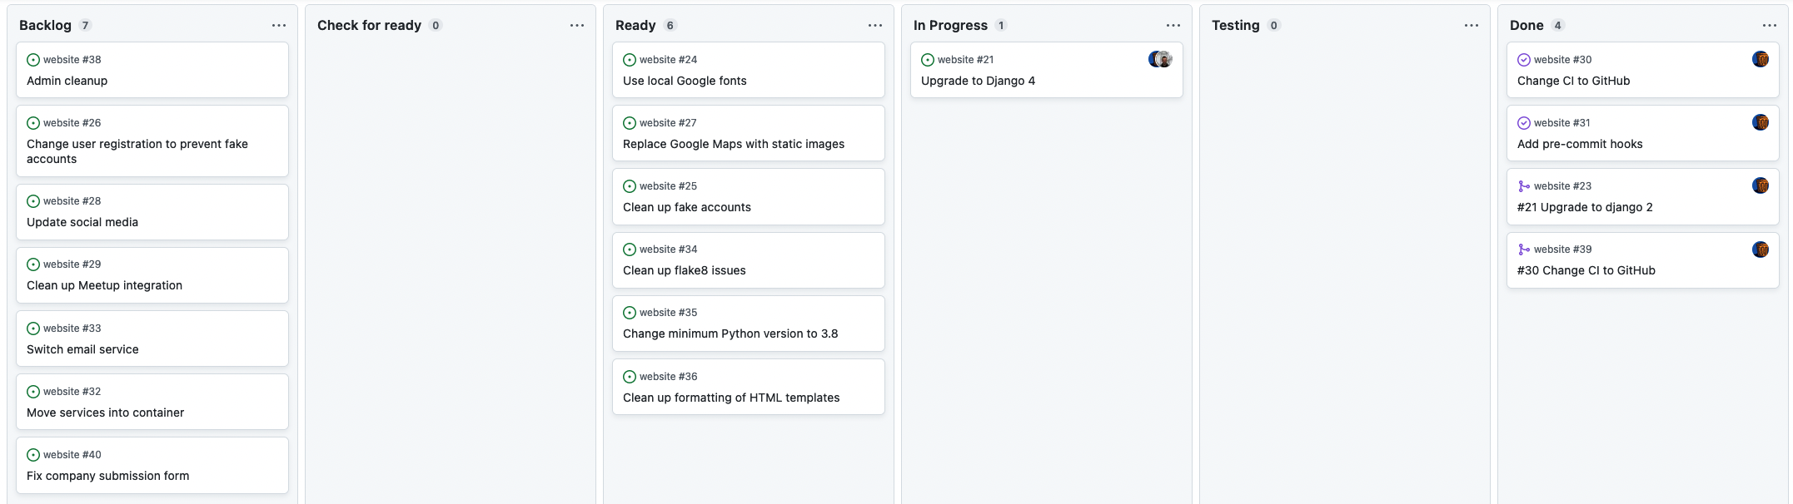
PyGRAZ Kanban board

Slide 6
PyGRAZ Kanban board
Does everyone understand what is needed?
Still clarifying what is needed
We can start any time
Someone is actively working on it
All done

Slide 7
Developer workflow for each task
For each task, make a git branch
  Branch naming: slug starting with task number
  For example: 30-change-ci-to-github
When done, open a pull request
  For example: https://github.com/pygraz/website/pull/39
Continues integration automatically runs test suite
Someone else reviews the pull request
If everything is fine, merge into the main/develop branch

Slide 8
Guidelines for commit messages
Example: #30 Fix path to requirements
Start with task number. For example: 30
Begin with a verb. For example: Add, Fix, Change, Clean up, ...
Finish the description with more details.
  No dot at the end → consider the first line a heading
If more details are needed, add an empty line and the details needed to understand the commit

Slide 9
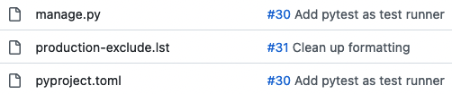
How to start commit messages with #
Normally # is used as comment char in commit messages
To change this, run for example:
git config --global core.commentChar ";"
In GitHub and other issue trackers, this automatically creates links

Slide 10

Let’s get started!
Source: https://pixabay.com/photos/athlete-runner-sprint-fast-black-1840437/

